Slide 1

IBM DataScience
CapSTONE PROJECT PRESENTATION
By Sourabh Chitranshi

Slide 2
INTRODUCTION
The PurpOSE OF THE PROJECT

Slide 3
Business Problem
This Capstone Project aim to create an analysis of features for a people migrating to Scarborough to search a best neighborhood as a comparative analysis between neighborhoods. The features include median housing price and better school according to ratings, crime rates of that particular area, road connectivity, weather conditions, good management for emergency, water resources both freash and waste water and excrement conveyed in sewers and recreational facilities.

Slide 4
Data Used IN THE PROJECT

Slide 5
Defining the Data
Data Link: https://en.wikipedia.org/wiki/List_of_postal_codes_of_Canada:_M
Will use Scarborough dataset which we scrapped from wikipedia on Week 3. Dataset consisting of latitude and longitude, zip codes.
Foursquare API to gather information about venues inside each and every neighborhood. For each neighborhood, we have chosen the radius to be 100 meter.

Slide 6
Defining the Data
Data Link: https://en.wikipedia.org/wiki/List_of_postal_codes_of_Canada:_M
Will use Scarborough dataset which we scrapped from wikipedia on Week 3. Dataset consisting of latitude and longitude, zip codes.
Foursquare API to gather information about venues inside each and every neighborhood. For each neighborhood, we have chosen the radius to be 100 meter.

Slide 7
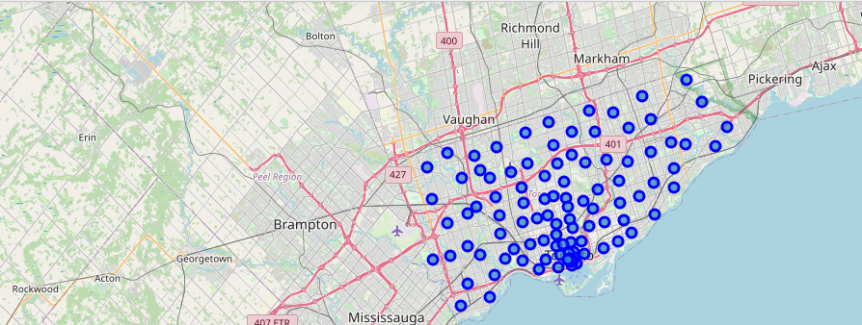
The Map Scarborough

Slide 8
Clustering Approach

Slide 9
Methodology
To compare the similarities of two cities, we decided to explore neighborhoods, segment them, and group them into clusters to find similar neighborhoods in a big city like New York and Toronto. To be able to do that, we need to cluster data which is a form of unsupervised machine learning: k-means clustering algorithm.
Using credentials of Foursquare API features of near-by places of the neighborhoods would be mined. Due to http request limitations the number of places per neighborhood parameter would reasonably be set to 100 and the radius parameter would be set to 500.

Slide 10
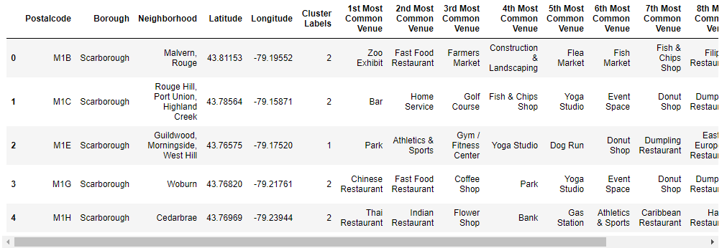
Most Common Venues near Neighborhood

Slide 11
RESULTS

Slide 12
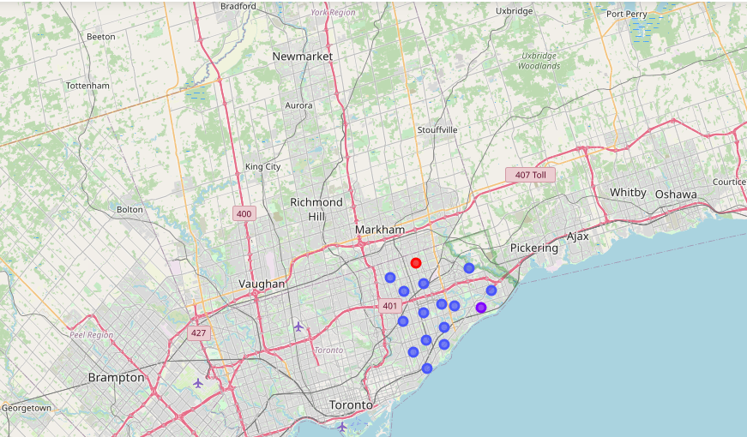
Clustering in Scarborough

Slide 13
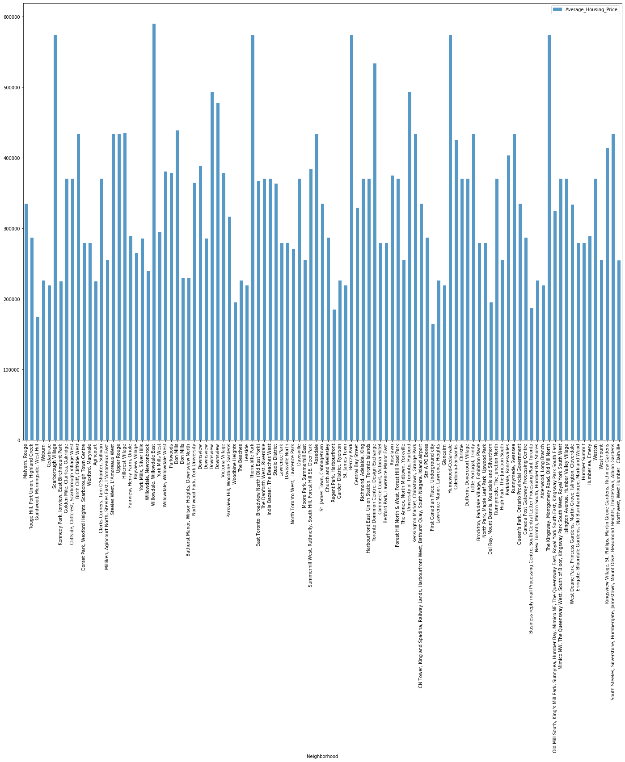
Average Housing Price in Scarborough

Slide 14
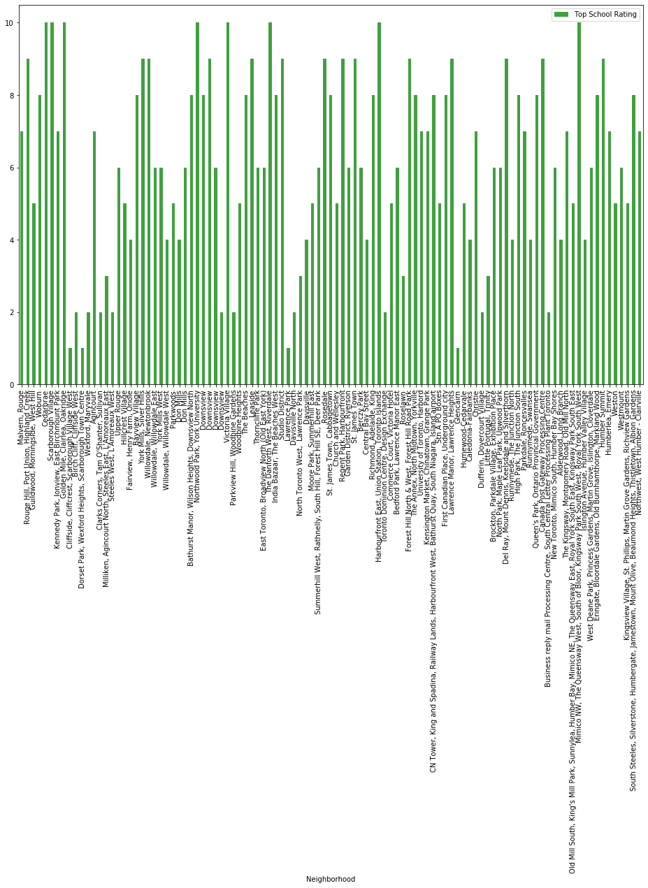
Schools By Ratings in Scarborough

Slide 15
Conclusion

Slide 16
Methodology
In this Capstone project, using k-means cluster algorithm I separated the neighborhood into 10(Ten) different clusters and for 103 different lattitude and logitude from dataset, which have very-similar neighborhoods around them. Using the charts above results presented to a particular neighborhood based on average house prices and school rating have been made.

Slide 17
Thank YOU

